Slide 1
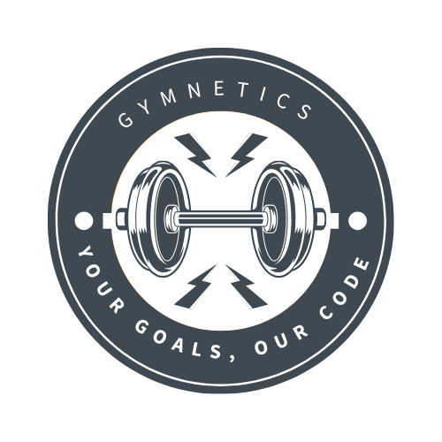
Gymnetics User Manual
Team Byte Squad

Slide 2
Table of Contents
4.Personalized Recommendations
Entering Fitness Information
Receiving Recommendations
Adding Items to Cart
Checkout
5. Managing Your Profile
6.Video Tutorial
7.Contact & Support
Introduction
Getting Started
Creating an Account
Logging In
Navigating the Home Page
Workout Plans
AI Workout Generator
AI Supplement Recommender
Personalized Recommendations
Entering Fitness Information
Receiving Recommendations
Adding Items to Cart
Checkout

Slide 3
Introduction
Welcome to Gymnetics, an AI-powered fitness web application designed to provide personalized workout routines and supplement recommendations. With Gymnetics, you can:
Create and manage your fitness profile.
Explore general workout plans.
Generate customized workout routines based on your goals, weight, height, and experience level.
Receive supplement recommendations tailored to your fitness needs.
Purchase supplements directly through the platform.

Slide 4
Getting Started
Creating an Account
Open the Gymnetics web application.
Click Sign Up.
Enter your information (name, email, password).
Confirm your details and submit.
Your account is now created, and you can log in anytime.

Slide 5
Logging In
On the login page, enter your registered email and password.
Click Login.
If you forget your password, use the Forgot Password feature to reset it.

Slide 6
Navigating the Home Page
Once logged in, you are taken to the Home Page. Here, you’ll find three main sections:
Workout Plans: Explore a library of basic workout routines suitable for all levels.
AI Workout Generator
Input your weight, height, fitness goals, and experience level.
Click Generate Workout.
The system will create a personalized workout routine just for you.
AI Supplement Recommender
Input your weight, height, and fitness goals.
Click Get Recommendations.
The AI will generate a supplement plan designed to support your workout routine.

Slide 7
Personalized Recommendations
Entering Fitness Information
Fill in the required details such as:
Weight
Height
Fitness Goals (e.g., muscle gain, weight loss, endurance)

Slide 8
Receiving Recommendations
After submitting your details, you will receive your recommendations.
Your workout routine will be displayed.
Your supplement recommendations will be listed with detailed explanations.

Slide 9
Adding Items to Cart
Adding Items to Cart
Each supplement includes an Add to Cart button.
Click the button to add items to your shopping cart.

Slide 10
Checkout
Go to the Cart page.
Review your items.
Click Checkout.
Complete your payment through the secure checkout system.

Slide 11
Managing Your Profile
You can update your account information at any time:
From the dashboard, click your account icon (top right corner).
Select Profile.
Edit your details (name, email, age, fitness goals, physical status).
Save changes.

Slide 12
Video Tutorial
For a complete walkthrough of the Gymnetics platform, watch the step-by-step demo:
🎥 Gymnetics Demo Video

Slide 13
Contact & Support
If you encounter issues or have questions:
Email us: gymnetics@gmail.com
Reach out to the Gymnetics development team via the GitHub repository: 👉 Gymnetics GitHub

